Slide 1
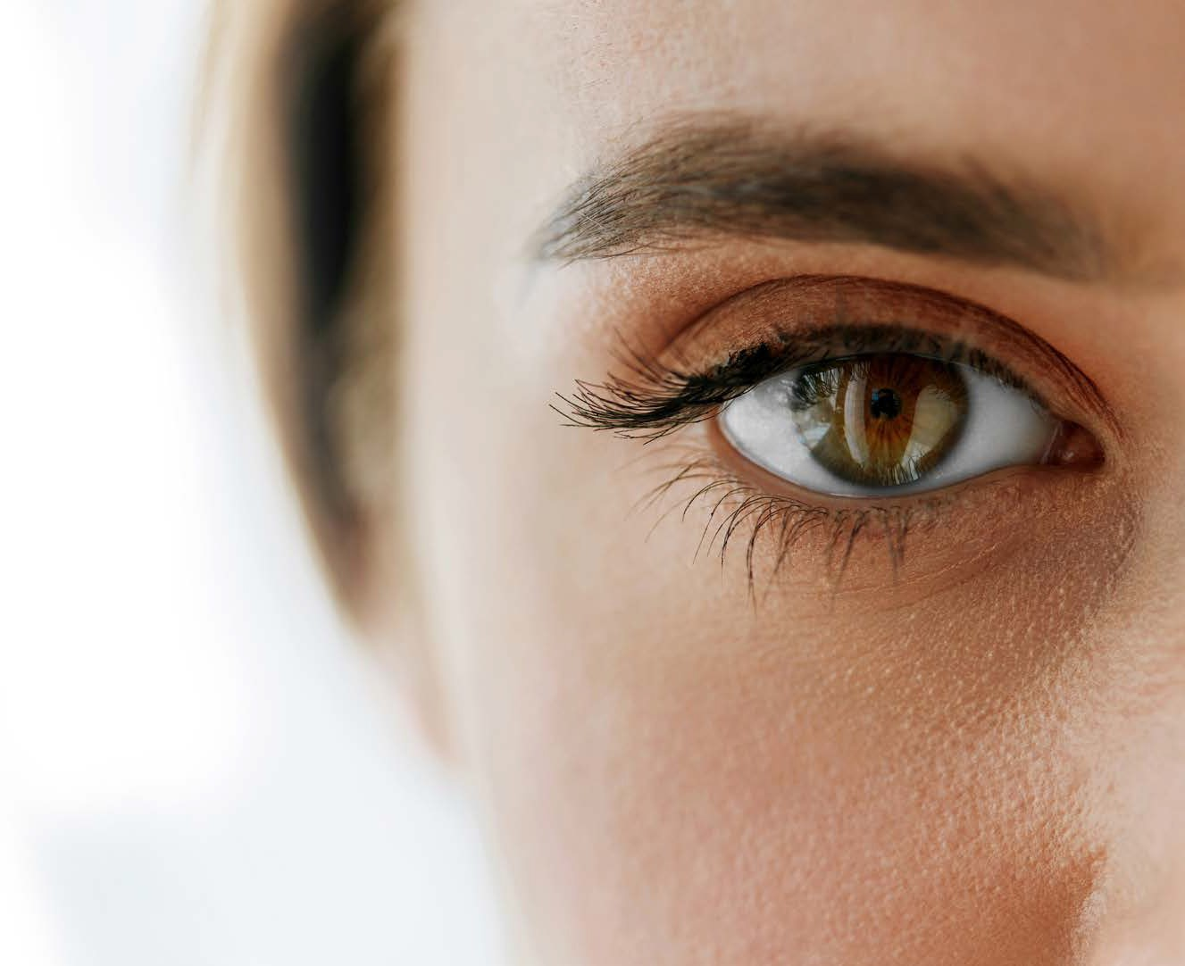
INNOVATION
IN EYE CARE

Slide 2
Overall Aim of Course
Introduction to Eye Care
Dry Eye Disease – Causes, Symptoms and Treatment
Preserved Vs Preservative Free Eye Drops
Introducing Viz Opti
The Commercial Proposition

Slide 3
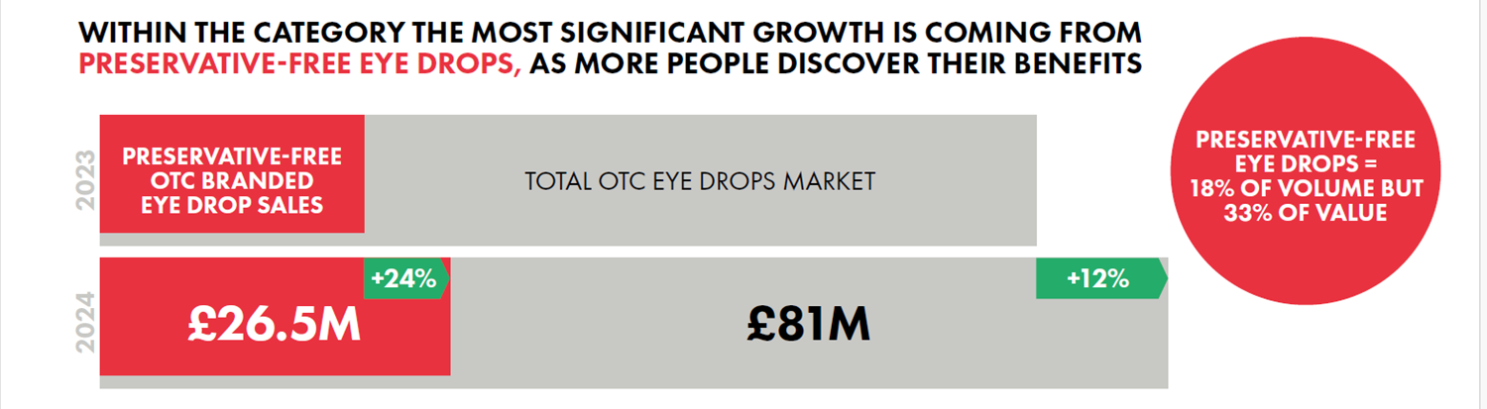
Introduction to Eye Care
£120m + Eye Market Category Value seeing a large increase in shopper /patient numbers driven by:
    Ageing Population
    Daily Screen Usage +6 Hours
    Contact Lens Use
    Corrective Eye Surgery
Different options within this category
    Dry Eye Treatment
    Eye Hygiene
    Allergy and Irritated Eyes
    Eye Infections
Preservative Free – Growing Share in a growing market
+24
+12%
£26.5M

Slide 4
Dry Eye Disease
Dry eye disease is a common condition that occurs when your tears aren't able to provide adequate lubrication for your eyes. Tears can be inadequate and unstable for many reasons. For example, dry eyes may occur if you don't produce enough tears or if you produce poor-quality tears. This tear instability leads to inflammation and damage of the eye's surface.
Dry eyes feel uncomfortable. If you have dry eyes, your eyes may sting or burn. You may experience dry eyes in certain situations, such as on an airplane, in an air-conditioned room, while riding a bike or after looking at a computer screen for a few hours.
Treatments for dry eyes may make you more comfortable. These treatments can include lifestyle changes and eye drops. You'll likely need to take these measures indefinitely to control the symptoms of dry eyes.
Causes
You may be more likely to get dry eyes if:
you're over the age of 50
you wear contact lenses
you look at computer screens for a long time without a break
you spend time in air conditioned or heated environments
it's windy, cold, dry or dusty
you smoke or drink alcohol
you take certain medicines (for example, some antidepressants or blood pressure drugs)
you have a condition, such as blepharitis, Sjögren's syndrome or lupus
Symptoms
The symptoms of dry eyes vary from person to person in severity, but can include:
dry, irritated, and uncomfortable eyes
a burning, gritty sensation
the feeling of a foreign object in your eye
sore, red eyes
temporarily blurred vision, which usually improves when you blink
watery eyes caused by excessive tear production
You may also notice a mucous discharge, particularly when you wake up in the morning, which can cause your eyelids to stick together. The condition tends to affect both eyes, but sometimes one eye may be more affected than the other.
Treatment
The symptoms of dry eyes vary from person to person in severity, but can include:
Condition Management
Adjustments to Lifestyle, Air Conditioning and Heating
Heat the affected area
Firm massage
Ocular Lubricants
Diet and Supplements
+24
+12%
£26.5M

Slide 5
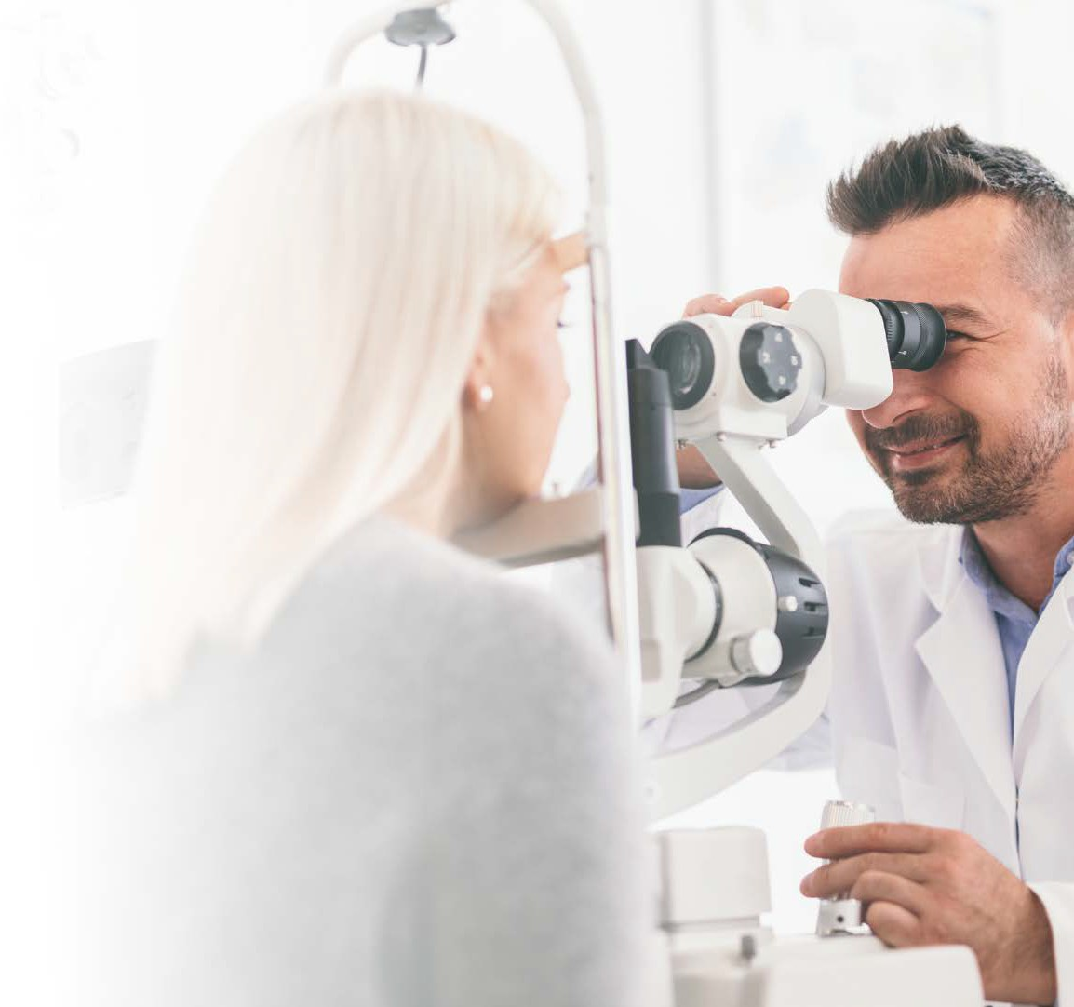

Benefits of Preservative Free
BENEFITS OF USING PRESERVATIVE FREE EYE DROPS OVER REGULAR EYE DROPS
BENEFITS:
Less invasive on the eye surface Less irritation to the ocular surface Help prevent further cell damage
Help prevent worsening of symptoms Fewer side effects
More widely tolerated
Better user compliance to treatment
Improved patient symptoms and control of condition Improved quality of life
SUITABILITY:
People with sensitive eyes Contact lens wearers
High daily dosage (+ 4 times a day)
Long-term treatment of moderate/severe Dry Eyes After eye surgery
Preservative allergy
If already using other preserved drops on a long-term daily basis (e.g. glaucoma patients)

Slide 6
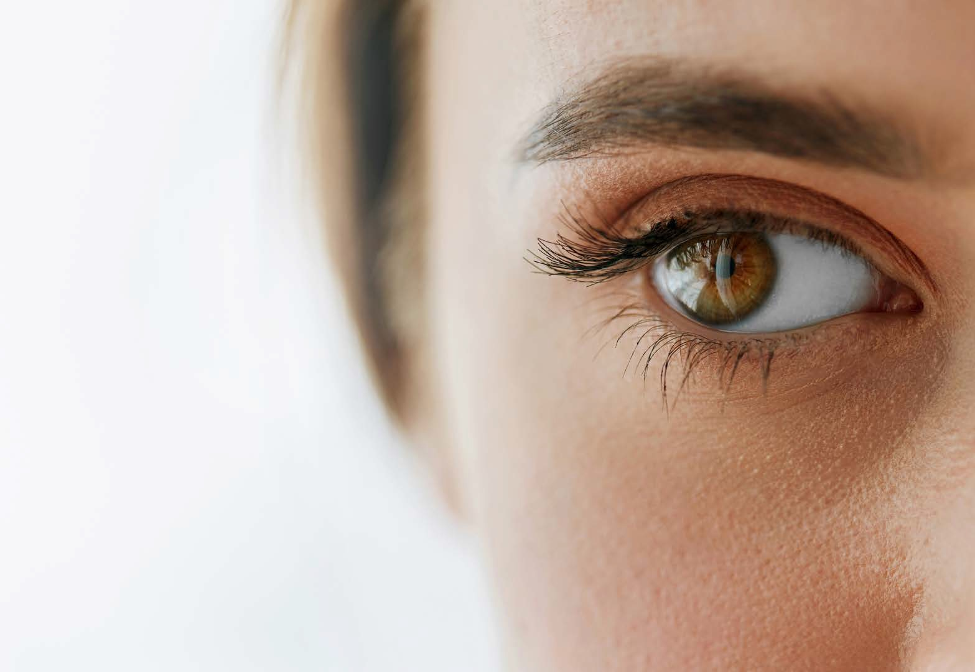
Introducing

Slide 7
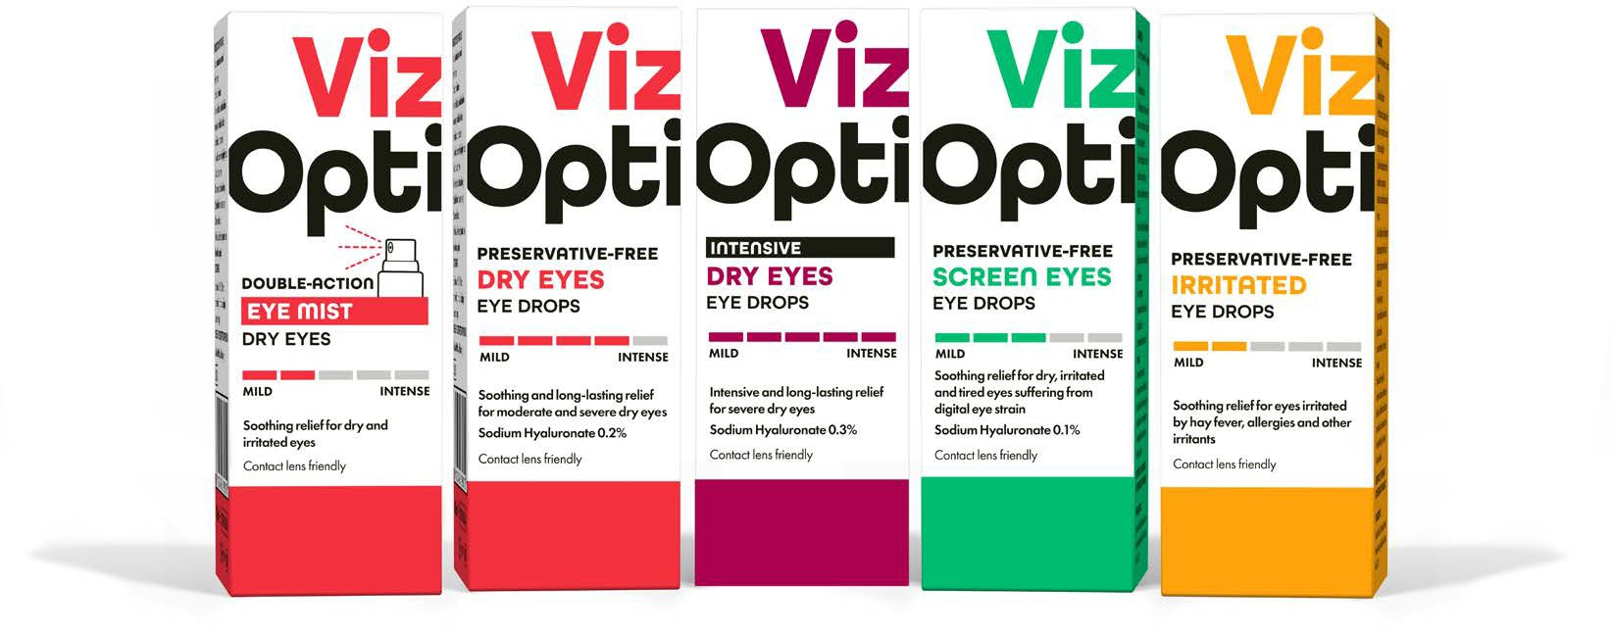
These are all the products in the VizOpti range and can be offered in place of other leading preservative free eye drops like Hycosan

Slide 8
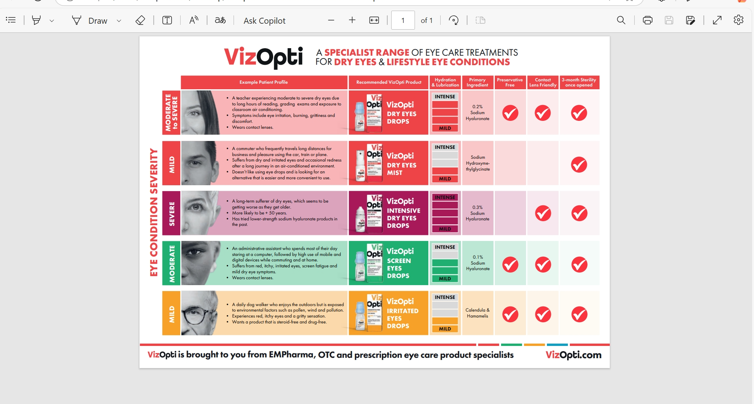

Slide 9
The leading solution for Preservative-Free over-the- counter and prescription products.
VizOpti preservative-free products are presented in an innovative preservative-free,
multi-dose ophthalmic squeeze dispenser
Easy & intuitive to use
Accurate dropper mechanism
Enables the user to administer single drops
Patented tip-seal technology
Maintains product sterility throughout
the treatment period
Ergonomic squeezable container has a low actuation force
Suitable for all consumers including
those with reduced dexterity
Compact pocket size
Convenient for on-the-go usage
A leading solution for preservative-free prescription and over-the-counter products. Featuring proven microbiological integrity and with an outstanding track record of more than 500 market references worldwide, it is the technology of choice for multidose, preservative-free systems in eye care.

Slide 10
Competitively priced for the consumer, delivering excellent trade terms
 | Viz Opti Preservative Free Dry Eyes Eye Drops | Hycosan Extra Eye Drops Preservative Free
Active Ingredient | 0.2% Sodium Hyaluronate | 0.2% Sodium Hyaluronate
RRP | £9.99 | £11.99
Trade Price | £3.66 | £6.66
Lower RRP for the consumer
Lower Cost / Greater margin for the Retailer

Slide 11
THANK YOU FOR COMPLETING THIS TRAINING MODULE
Please now complete the assessment. Copy the below link:
https://forms.office.com/e/GCpfGW13Wa

Slide 12
Quiz
Which statement is correct:
          Dry eye disease is a common condition that occurs when your tears aren't able to provide adequate lubrication for your eyes.
          Dry eye disease is a common condition that occurs when your tears are able to provide adequate lubrication for your eyes.
2) What brand of eye drops are the main comparison product for VizOpti
Hycosan
Optrex
3) Which statement is correct:
If you have dry eyes, your eyes may sting or burn.
If you have dry eyes, your eyes may itch.
4) How many products are there in the VizOpti range
1
3
5
7
5) Why is VizOpti the better brand to recommend?
Lower RRP (Recommended Retail Price)
Greater Margin for the retailer
All of the above

